Slide 1
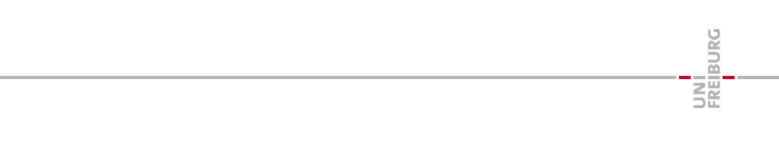
Model-Reconstruction
Retrieving system dynamics from it’s time series.

Slide 2
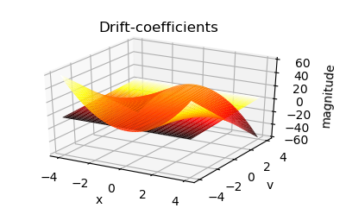
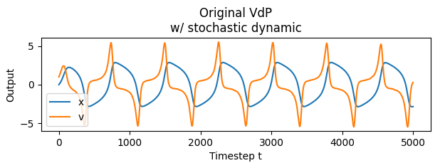
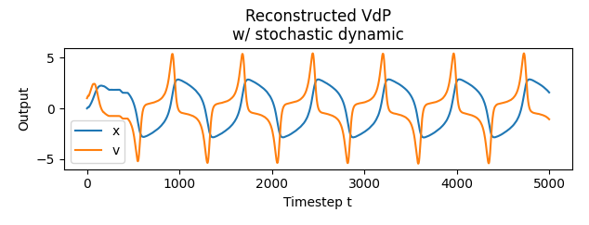
Overview
1. Gathering time-series eg. the Van-der-Pol oscillator
2. Retrieve estimated drift- & diffusion coefficients
3. Reconstruct the systems time-series from the dynamics

Slide 3
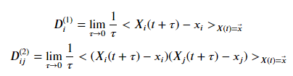
Method used
The method used was proposed by J.Gradisek, S.Riegert, R.Freidrich, I.Grabec in „Analysis of time series from stochastic processes”, year 2000 [1]
Drift- and diffusion-coefficients can be directly derived from the time-series by using their statistical definition: [2]
Drift-coefficient
Diffusion-coefficient
$<⋅>$ → arithmetic mean
For „good“ results the process should be exposed to gaussian noise.

Slide 4
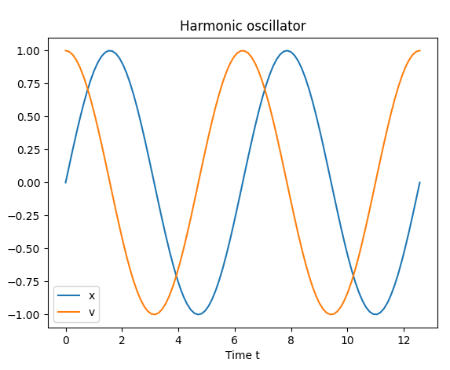
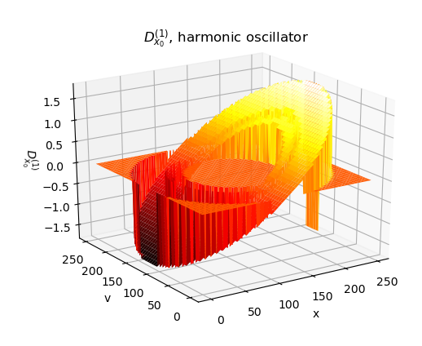
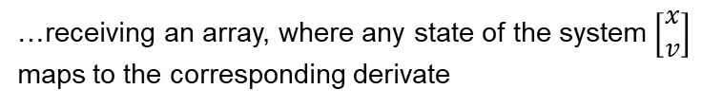
Method used
For any point in the series, where all dimensions have the same value, we calculate the time-derivate for all dimensions.
THIS IS HIDDEN
Same value in x, but not in v!
CONTENT DUPLICATE
…receiving an array, where any state of the system $\left[\begin{matrix}x \\ v\end{matrix}\right]$ maps to the corresponding derivate

Slide 5
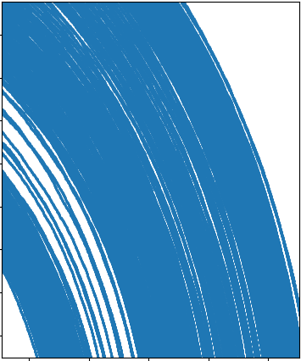

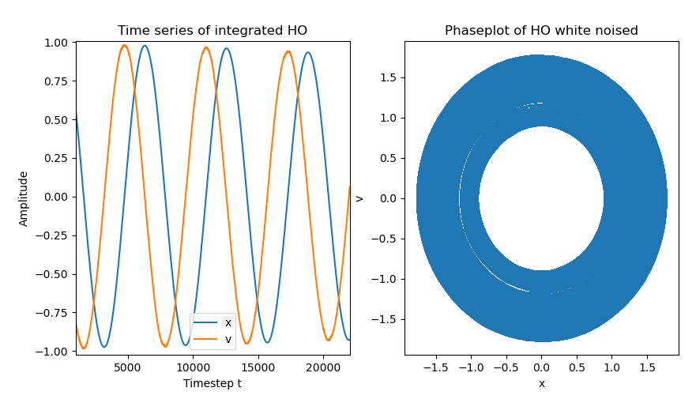
Method used
For any point in the series, where all dimensions have the same value, we calculate the time-derivate for all dimensions.
Same value in x, but not in v!

Slide 6
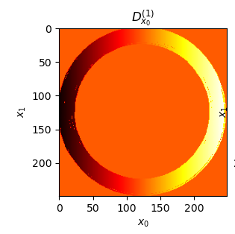
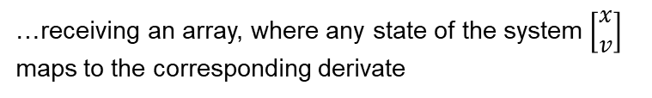
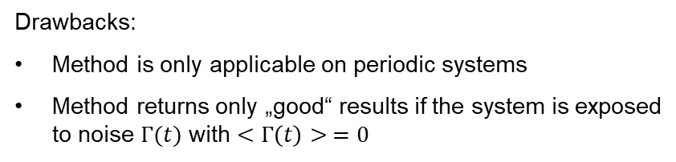
Method used
…receiving an array, where any state of the system $\left[\begin{matrix}x \\ v\end{matrix}\right]$ maps to the corresponding derivate
Drawbacks:
Method is only applicable on periodic systems
Method returns only „good“ results if the system is exposed to noise $Γ(t)$ with $<Γ\left(t\right)> =0$

Slide 7
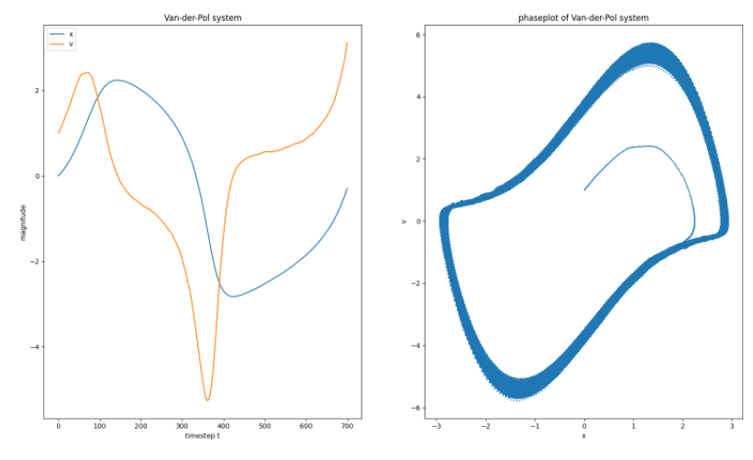
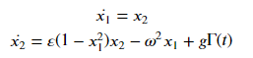
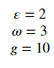
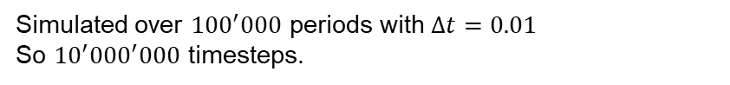
Application
Practically applied to a simulated Van-der-Pol Oscillator.
Simulated over ${100}^{′}000$ periods with $Δt=0.01$ So ${10}^{′}{000}^{′}000$ timesteps.

Slide 8
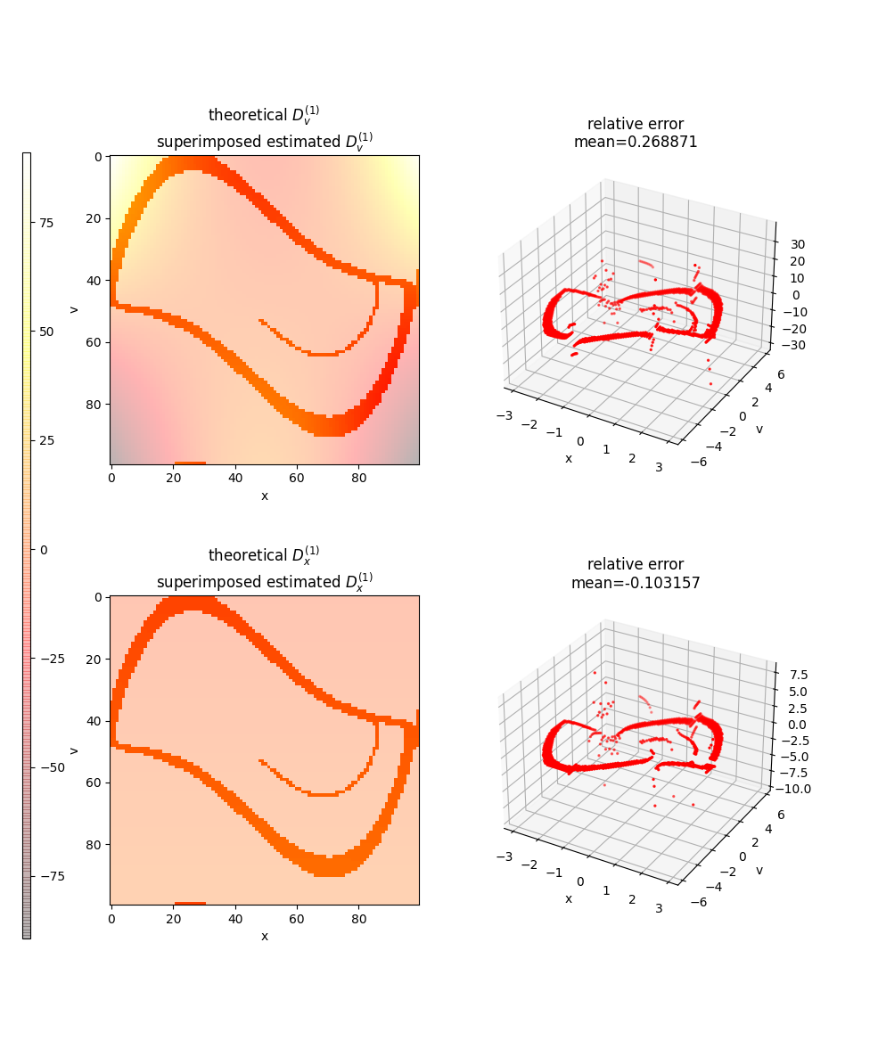
Application

Slide 9
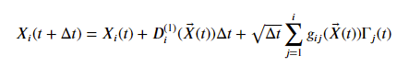
Reconstruction
With the estimated Drift-coefficient the reconstructioncan be easily done using: [1]
System‘s previous value
Stochastic proportion, noise
Drift-coefficient at the previous state of the system
„Adding to the system‘s current values the estimated mean change at the system‘s state.“

Slide 10
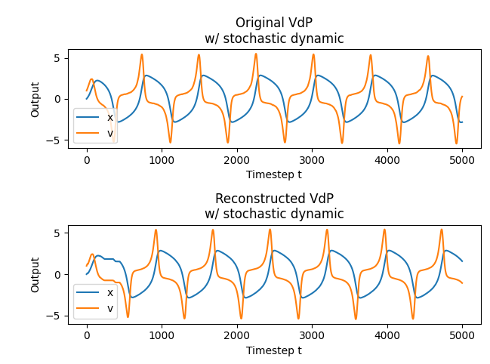
Reconstruction
„Settling process“

Slide 11
Fokker-Planck-Analysis
To proof the correctness of the estimated coefficients, we use the Fokker-Planck equation (FPE) inserting the estimated coefficients.
So far only done with analytical coefficients.
In case of the Van-der-Pol oscillator the FPE reads the following:
Problems occured with the „normal“ derivate (the system swinged open), so we used the second-order-upwind scheme to derivate.

Slide 12
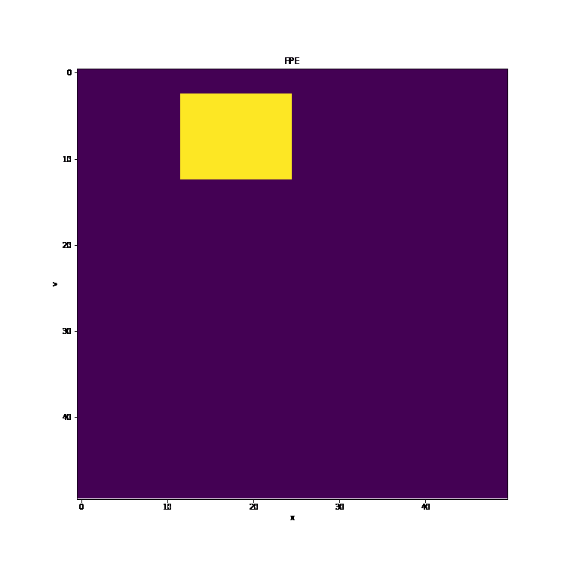
Fokker-Planck-Analysis
Result with the analytic coefficients of the Van-der-Pol oscillator:
Not clearly visible here: But this results „runs“ over time to infinite values.
v
Next steps here:
Evaluate FPE with estimated coefficients
Comparing results with an analytical solution
x
AN ANALYTIC FPE SOLUTION WOULD BE ALSO GREAT HERE

Slide 13
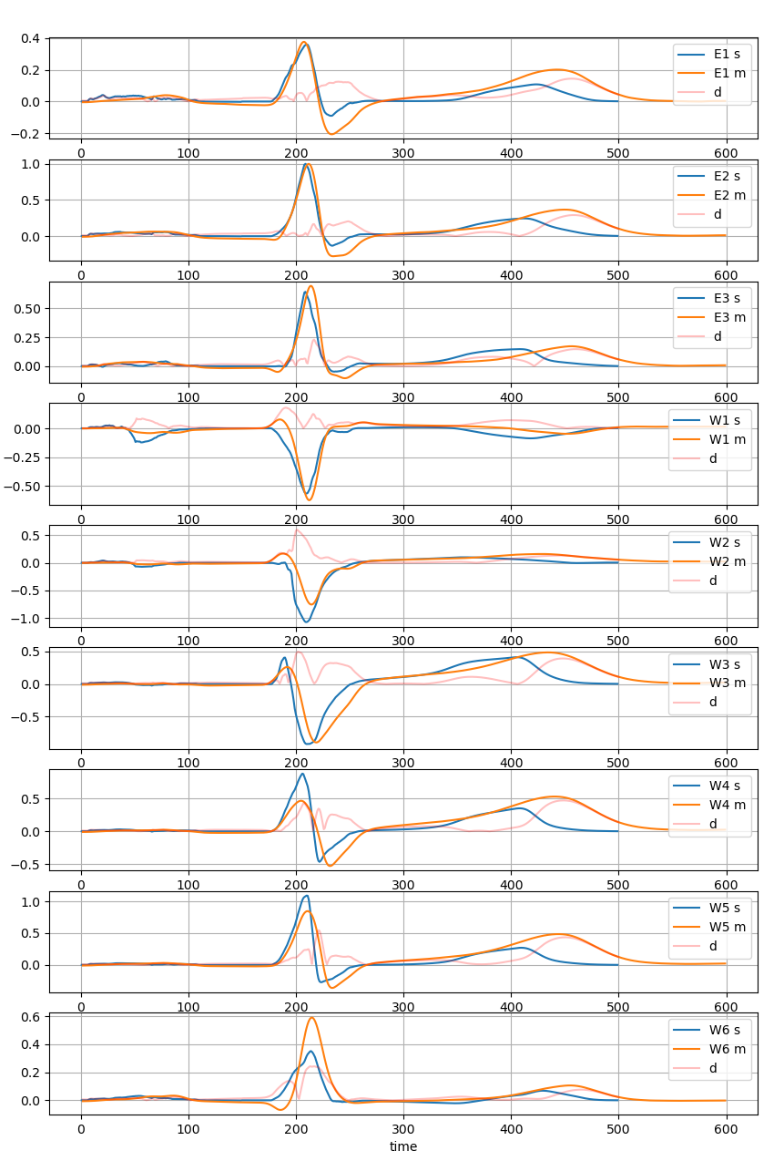
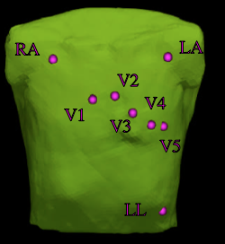
Outlook
Applying this method to simulated and experimental ECG data.
Data provided by Robin Moss.
Reconstruct the ECG System.
Electrodes positions

